Slide 1
Welcome
Egg Donation
Basics

Slide 2
Objectives
When you leave today, you should…
Be familiar with the egg donation process
Know that an egg donation cycle requires multiple office visits, some of which are time-sensitive and scheduled with short notice.

Slide 3
Objectives
When you leave today, you should…
Be comfortable administering subcutaneous injections.
Know your next step if you decide to continue screening to become an anonymous egg donor

Slide 4
What You Will Not Learn
When you leave today, you will not be expected to know…
Exact dosages of medications
Exact timing of medications
Your specific stimulation plan

Slide 5
Egg Donation
Involves the use of injectable fertility medications to stimulate the ovaries in order to produce multiple eggs, which will be surgically removed and made available for recipient couples to use for an IVF (in vitro fertilization) cycle.

Slide 6
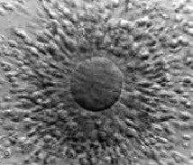
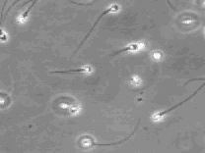

In Vitro Fertilization
A process where fertilization takes place outside the body, in a petri dish or a test tube

Slide 7
Risks of Egg Donation/ Egg Retrieval
Ovarian Hyperstimulation Syndrome (OHSS)- about 2-3% risk with use of injectable fertility medication to cause eggs to develop
Risk of puncture of bladder, bowel , blood vessel or other structure in the area of the ovaries during the egg retrieval procedure
Risk of pelvic infection with the egg retrieval procedure

Slide 8
The Egg Donation Cycle
Getting Started
Suppressing the Ovaries
Ovarian Stimulation
Egg Retrieval

Slide 9

Getting started
Be As Healthy As You Can Be:
Take a Multivitamin daily
Check with the IVF Nurse re: Medications Safe to Take while Stimulating in the Egg Donation Cycle
No Alcohol or Smoking
Decrease Caffeine to 50mg (8 oz.) per Day
Notes:
Medications Safe in Pregnancy: Tylenol, Sudafed, Benadryl, etc. Ask your IVF nurse or pharmacist if there is a question.

Slide 10
Getting started
Your Egg Donation Cycle Begins with Your Menses:
Call your IVF Nurse with the first day of FULL FLOW bleeding. Call on Monday if your period starts over the weekend.

Slide 11
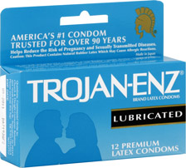
Getting started
Do not have sex throughout your egg donation cycle. You are very fertile at this time and could get pregnant unexpectedly.

Slide 12
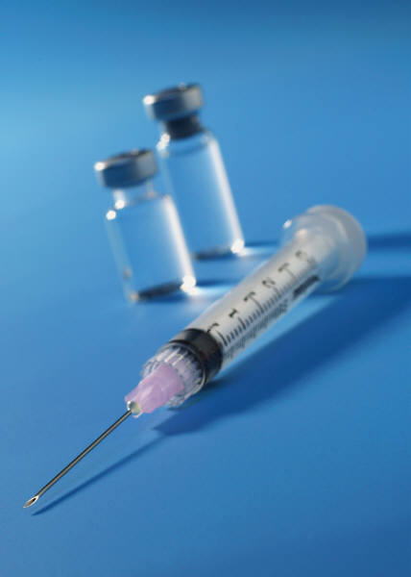
Getting started
Your IVF Nurse will order your medications from a specialty mail-order pharmacy.
Your cycle medications will be reviewed and the complete supply given to you at the first monitoring visit in the donation cycle (called the suppression check)

Slide 13
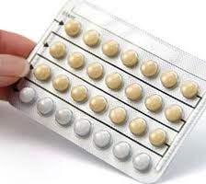
Begin Birth Control Pills (CD3)
Begin birth control pills on the third day of your menstrual cycle if these have been prescribed for you.
  Take pills at night and with food if they cause nausea.
  You may have breakthrough bleeding while on birth control pills. This is not cause for concern.

Slide 14
Birth Control Pills
Usually taken daily for 2 to 4 weeks.
Birth control pills are used to prevent cysts from forming on the ovaries during this suppression stage.

Slide 15
Getting started
Your IVF nurse will send you a personalized plan.
Your menses began on__________
You should begin taking birth control pills on cycle day 3________
You will take your last active birth control pill on__________
Schedule a suppression check for ____________
Begin FSH (Follistim or Gonal-F and/or Menopur) on______ (~2- 3 days after the suppression check , as directed)
Schedule an Estradiol level and ultrasound appointment on FSH day 4 or 5 and thereafter as advised.
Anticipate starting Ganirelix in addition to FSH around day 6 of stimulation, but we will instruct you when to start this medication. You will need to continue this medication for as long as you are taking FSH.
Your egg retrieval will be the week of ________________
Notes:
Please note that the calendar you previously received is a sample only.

Slide 16
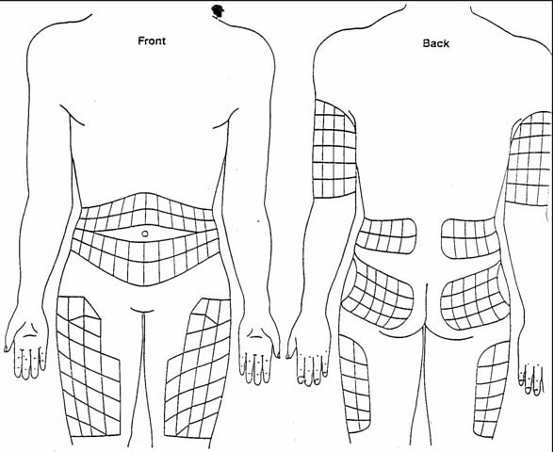
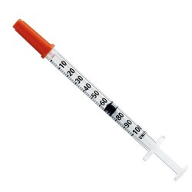
Subcutaneous Injection Sites
All of the injectable cycle medications: FSH (Follistim, Gonal F) hMG (Menopur), Ganirelix, and Leuprolide (Lupron) trigger are given as subcutaneous injections.

Slide 17
Stop Birth Control Pills ≈ CD23
Around Cycle Day 23, you will stop your birth control pills (as instructed on your personal plan).
Two to four days after stopping the pill, you will come in for the first visit in the donation cycle (as instructed on your personal plan) . It is called the “Suppression Check”.
You may or may not be on a menses and this is ok.

Slide 18
Suppression Check Visit
The Suppression Check visit includes
    estradiol level (blood test)
    pelvic ultrasound
    history and physical exam
    Infectious disease blood panel (required by the FDA for all egg donors in cycle)
This appointment can take up to an hour.

Slide 19
Suppression Check Visit
You will receive an updated written plan from your IVF nurse.
Your IVF nurse will review and give you the complete cycle medication supply at this suppression check appt.
You will be instructed in the dose ,timing, and administration of each medication, as well as future office visits.

Slide 20

Suppression Check Visit
Voicemail Box
You will be given a voicemail box upon checkout.
Check your voicemail this afternoon (3:30pm) and any day you come in for monitoring visits in the egg donation cycle.

Slide 21
Starting the Stimulation with the
Fertility Medications
If your ovaries are suppressed at your suppression check visit, you will be instructed to begin FSH/hMG fertility medication injections.
You will be taking FSH/hMG injections either once or twice a day, depending on the plan your doctor has selected for you
All forms of FSH/hMG are administered subcutaneously (under skin with a short needle)

Slide 22

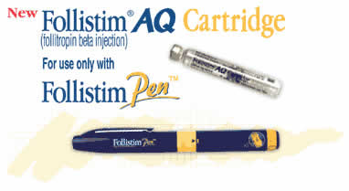
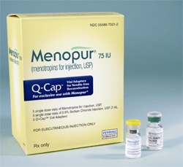

Stimulating with Fertility Medication :
Follicle Stimulating Hormone (FSH)
You may be using one or more of these fertility medications based upon your plan:

Slide 23



Stimulating with the fertility medication:
Follicle Stimulating Hormone (FSH)
Once FSH (Follistim, Gonal F) and /or hMG (Menopur) begins,
Abstain from alcohol.
Stop all exercise except light walking.
No lifting over 10 pounds.

Slide 24
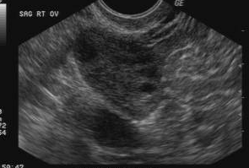
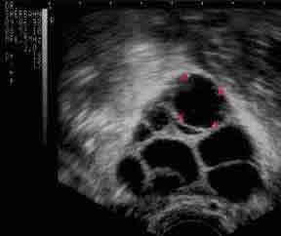
Normal and Stimulated Ovary

Slide 25
Stimulating the Ovaries:
(FSH Day 4)
You will come to our office for your first monitoring visit while on fertility medication injections. This visit will include an estradiol level (blood test) and an ultrasound
Check your voicemail box this afternoon for test results and plan
Your FSH/hMG doses may be increased or decreased at this time *make sure you have enough FSH/hMG*
There is a possibility that your cycle will be canceled if your estradiol level is too high or too low

Slide 26
Stimulating the Ovaries
(FSH Day 7)
You will come in for a second monitoring visit, consisting of an estradiol level and ultrasound
Check your voice mail box for your results and plan *make sure you have enough medicine*

Slide 27
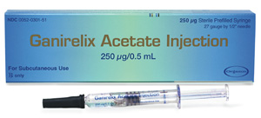
OVARIAN STIMULATION: Ganirelix
Expect to start taking Ganirelix around day 6 of FSH (this will be determined by your doctor).
The purpose of this medicine is to prevent ovulation.
Once instructed to start the Ganirelix, give one prefill syringe sub Q at ~ 10PM every evening that you take FSH/hMG.
You will do your last Ganirelix injection the evening before you take the Lupron Trigger.

Slide 28
OVARIAN STIMULATION:
Typical Stimulation on FSH
Eggs Retrieved
↓
Eggs Fertilized
↓
Good Embryos

Slide 29
OVARIAN STIMULATION:
(FSH Day 10)
3rd monitoring visit (estradiol level and ultrasound)
Listen to your voicemail box for your results and plan *make sure you have enough medicine*
Most people will take their trigger shot (Lupron) around day 10. Your voicemail will tell you exactly what time to take your trigger and your egg retrieval will be scheduled 35 hours later.

Slide 30
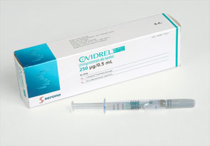
OVARIAN STIMULATION:
Ovidrel (HCG Trigger Shot)
ONE-TIME INJECTION
Ovidrel is human chorionic gonadotropin
Administered subcutaneously
Will be instructed to administer 1½ or 2 Ovidrel injections at the same time.
Accelerates maturation of the follicles and triggers ovulation.

Slide 31
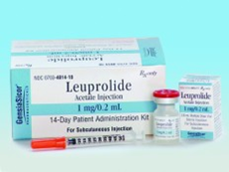
Or Lupron Trigger
To take a Lupron trigger, draw 0.8 mL using a 1 mL syringe and inject sub Q at the time instructed.
The following day your blood will be drawn for a LH level to confirm that lupron induced ovulation.
If ovulation is not detected, you will take an Ovidrel injection.

Slide 32
OVARIAN STIMULATION:
Day after Lupron Trigger
No medicines today (unless need additional trigger of Ovidrel)
Return to office for an estradiol level and LH level. (no ultrasound)
You will meet with an IVF nurse to review your instructions for your Egg Retrieval
NO EATING OR DRINKING AFTER MIDNIGHT TONIGHT (the night before your egg retrieval)

Slide 33
EGG RETRIEVAL

Slide 34
Egg Retrieval
Egg Retrieval is performed in our surgery center here at Nashville Fertility Center.
One of our Nashville Fertility physicians will perform your egg retrieval procedure.
You will have MAC anesthesia. (Twilight anesthesia given through an IV)
Your eggs will be frozen the day of retrieval using a fast-freezing method called vitrification or if a matched couple is in cycle with you, they will receive fresh eggs.

Slide 35
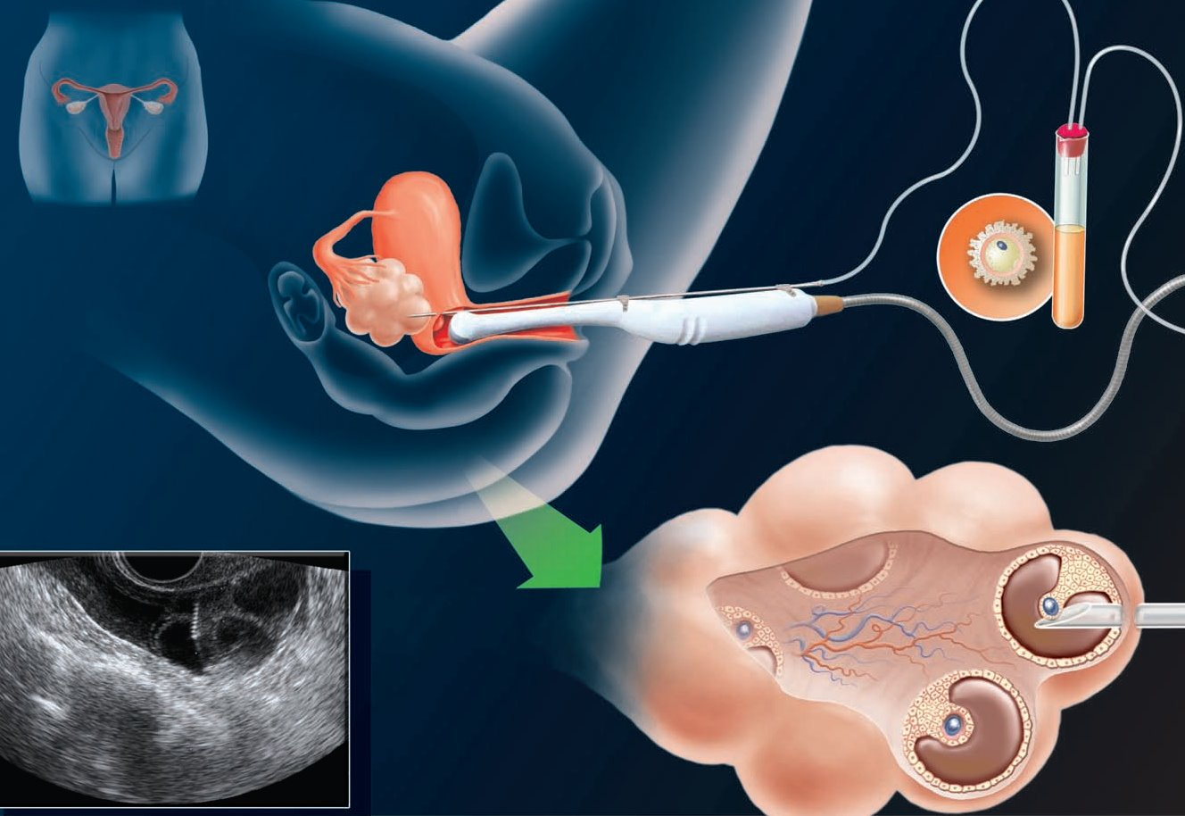
Egg Retrieval

Slide 36
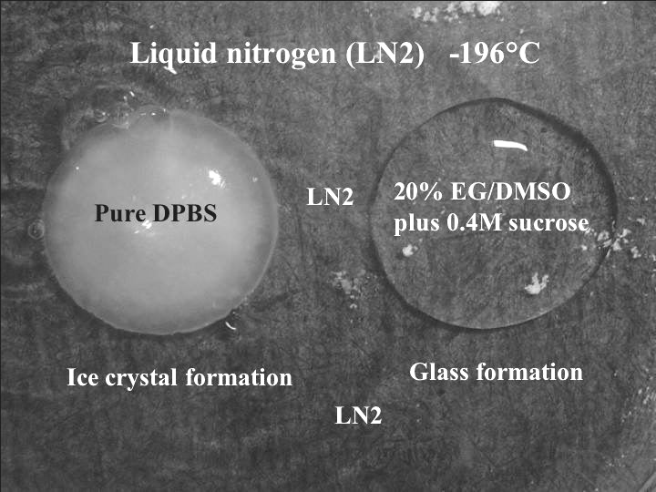
Vitrification
(Fast Egg Freezing)

Slide 37
Vitrification: Published Data
Survival: 85-90%
Fertilization: 85-90%
Blastocyst Development: 50-70%
Pregnancy Rate: 40-89%
Kuwayama et al, 2005; Chang et al, 2008; Nagy et al, 2009

Slide 38
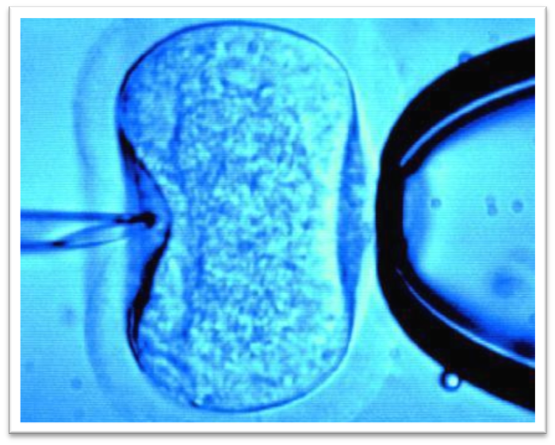
Fresh or Cryopreserved Donor Egg use
Anonymous donor eggs that have been frozen/thawed or fresh eggs, can be inseminated using ICSI - Intracytoplasmic Sperm Injection for a recipient match (utilizing the husband’s sperm)

Slide 39
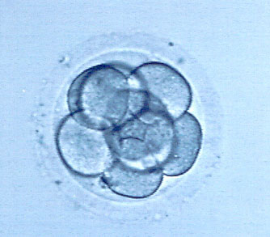
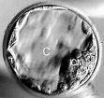
Embryo Development
Day 3 Embryo
Day 5 Embryo ‘Blastocyst’

Slide 40
Important Facts When You Donate Eggs
The donor egg program is set up to be anonymous, however, in today’s world of the internet, there is a possibility that children born from the use of donor eggs will be able to learn the identity of their egg donor, if motivated to do so.
Once your eggs are retrieved, you have no further control over these eggs, and they become the property of Nashville Fertility and subsequently, the recipient couple(s) who receives your eggs.
Recipients may decide to donate the donor egg/ embryos for: procreation to another individual or couple, for research, or they may discard them. You will not be notified of how they are used.
You may at any time elect to register with the National Donor Sibling Registry and Nashville Fertility will provide you with your egg donor # .

Slide 41
Tips for Success
Always make sure you have enough medication especially before the weekend.
Keep all appointments scheduled for you throughout the donation cycle, as instructed by your IVF nurse
Refer to the Nashville Fertility Center website for injection teaching videos:
www.nashvillefertility.com

Slide 42
Egg Donor Screening Steps
If you would like to continue the egg donor screening process:
We will draw a blood AMH level (anti muellarian hormone), to check your ovarian reserve or egg potential.
The nurse will call you with the AMH results and if the AMH level is over 2.0, you may continue with the next screening step below.
Schedule appointment to meet with one of the NFC physicians/ NPs, transvaginal ultrasound to check position of ovaries and # of follicles (egg potential), and draw Counsyl genetic mutation panel.
The nurse will call you with the Counsyl results and if acceptable, you will be instructed to call : Michele Martens, DNP,RN (615) 480-1811 to schedule an egg donor psychological evaluation appointment. The nurse will call you with results of the psychological evaluation.
You will then be added to the NFC donor active list and your profile will be made available for couples interested in using donor eggs to achieve a pregnancy.

Slide 43
Contact Information
Kelli Millett , APN, MSN
Egg Donation Program Coordinator
Tel: (615) 321-4740
Email: kmillett@nashvillefertility.com
Nashville Fertility Center Website
www.NashvilleFertility.com
Nashville Fertility Center
345 23rd Avenue North, Suite 401
Nashville, TN 37203
Michele A. Martens, DNP, RN
3rd Party Reproductive Counseling
Tel: (615) 480-1811
Email: fertilitycounselingnashville@gmail.com

